Slide 1


Hybrid Cloud Integration: Unlocking New Possibilities
Harness the power of hybrid cloud integration to enhance your business agility and unlock new possibilities for innovation. Hybrid cloud combines the best of both worlds, allowing you to leverage the benefits of public and private clouds simultaneously.

Slide 2
Challenges of Multi-Cloud Environments
Data Store House
Security Concerns
Vendor Lock-in
Different cloud platforms often lack seamless data sharing, leading to data silos(pit) and blocking efficient analysis.
Managing security across multiple clouds introduces complexity and requires a unified approach to mitigate risks.
Dependence on a single cloud provider can limit flexibility and increase switching costs in the future.

Slide 3

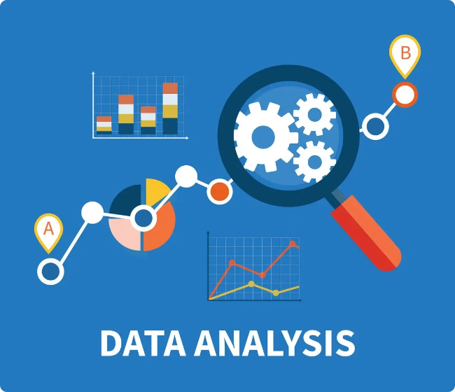
Benefits of Hybrid Cloud
Integration
1
Increased Flexibility
2
Enhanced Scalability
Hybrid cloud offers the flexibility to choose the best cloud solution for specific workloads, optimizing performance and cost.
Leveraging both public and private cloud resources enables seamless scaling to meet fluctuating demands.
3
Improved Disaster Recovery
4
Reduced Costs
Optimizing resource utilization across cloud environments can lower overall infrastructure costs.
Hybrid cloud provides redundancy and failover capabilities, ensuring business continuity in case of disruptions.

Slide 4

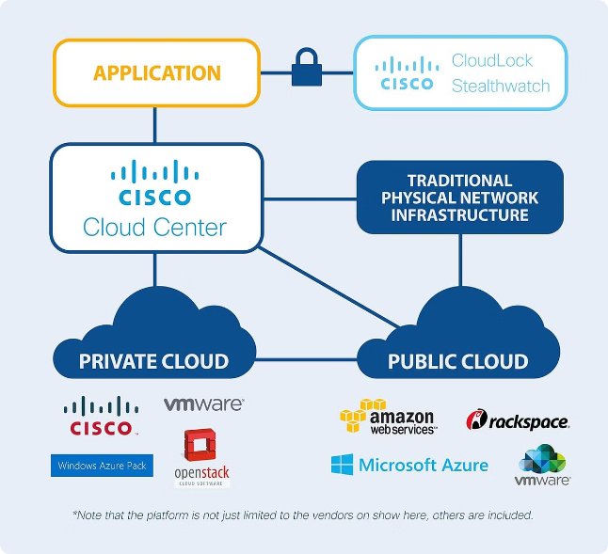
Hybrid Cloud Architecture Patterns
Cloud Bursting
Multi-Cloud Integration
Leveraging public cloud resources for peak demand, while keeping core operations on private cloud.
Connecting multiple public cloud providers for specific workloads, leveraging best-of-breed services.
Cloud Migration
Gradually migrating workloads from on-premises to public or private cloud, taking advantage of cloud benefits.

Slide 5


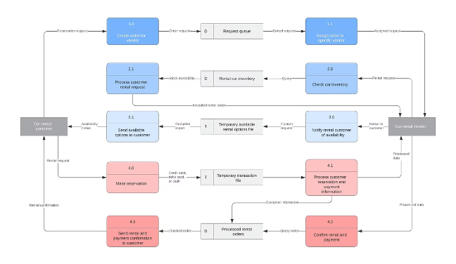


Data Integration in Hybrid Clouds
Data Replication
Replicating data between public and private cloud environments to ensure consistency and availability.
Data Transformation
Transforming data to align with different schemas and formats across cloud platforms.
Data Governance
Establishing policies and controls for data access, security, and compliance across hybrid cloud environments.

Slide 6

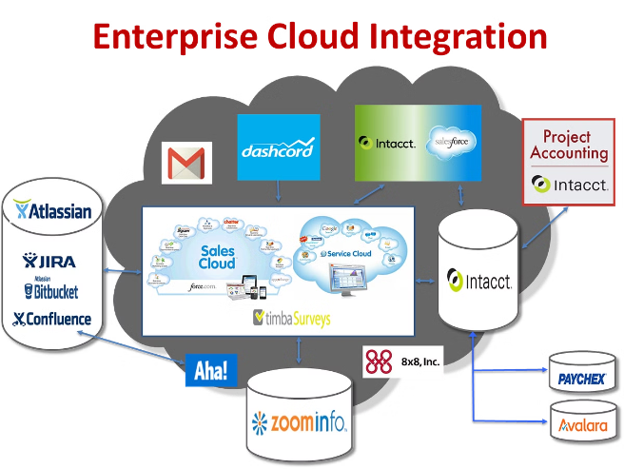
Application Integration in Hybrid Clouds
1
API Integration
Utilizing APIs to connect applications across different cloud platforms, enabling seamless communication and data exchange.
2
Microservices Architecture
Breaking down applications into smaller, independent services, allowing for flexible deployment and scaling across clouds.
3
Containerization
Encapsulating applications in containers for consistent deployment and portability across public and private clouds.

Slide 7





Security and Compliance Considerations
Data Encryption
Network Segmentation
Identity and Access Management
Compliance Frameworks
Encrypting sensitive data at rest and in transit to protect against unauthorized access.
Isolating network segments for different cloud environments to enhance security and restrict access.
Adhering to relevant industry standards and regulations for data protection and security.
Implementing strong authentication and authorization mechanisms to control access to cloud resources.

Slide 8

Hybrid Cloud Automation and Orchestration
Defining and managing cloud infrastructure using code for consistency and reproducibility.
Infrastructure as Code
Configuration Management
Automating the configuration of cloud resources and applications for efficient deployment and maintenance.
Orchestration Tools
Managing and coordinating the deployment and scaling of applications across hybrid cloud environments.

Slide 9


Hybrid Cloud Monitoring and Observability
Performance Monitoring
Log Analysis
Tracking key performance metrics of cloud resources and applications to identify and resolve performance bottlenecks.
Analyzing system logs for potential security threats, errors, and performance issues to improve troubleshooting and security.

Slide 10
Roadmap for Successful Hybrid Cloud Integration
Assessment and Planning
1
Conducting a thorough assessment of current infrastructure, business needs, and cloud options.
2
Architecture Design and Implementation
Designing and implementing a hybrid cloud architecture that meets specific business requirements.
Data Integration and Migration
3
Developing strategies for data integration, migration, and synchronization across cloud environments.
4
Security and Compliance
Implementing robust security measures and compliance frameworks to protect data and meet regulatory requirements.
Monitoring and Optimization
5
Establishing continuous monitoring and optimization processes to ensure optimal performance and efficiency.

